Slide 1
CS 774 OPTIMIZATION TECHNIQUES
Reading Project on Problems from Combinatorial Optimization

Slide 2
THE TRAVELLING SALESMAN PROBLEM

Slide 3
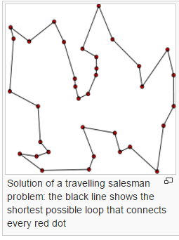
Overview
The travelling salesman problem (TSP) asks the following question: "Given a list of cities and the distances between each pair of cities, what is the shortest possible route that visits each city exactly once and returns to the original city?“
courtesy : Wikipedia

Slide 4
Formal Problem Statement
Definition: A complete graph is a graph with N vertices and an edge between every two vertices.
Definition: A Hamilton circuit is a circuit that uses every vertex of a graph once.
Definition: A weighted graph is a graph in which each edge is assigned a weight (representing the time, distance, or cost of traversing that edge).
The Traveling Salesman Problem (TSP) is the problem of finding a minimum-weight Hamilton circuit in a complete graph.

Slide 5
The Class P
A decision problem D is solvable in polynomial time or in
the class P, if there exists an algorithm A such that
A takes instances of D as inputs.
A always outputs the correct answer “Yes” or “No”.
There exists a polynomial p such that the execution of A on inputs of size n always terminates in p(n) or fewer steps.

Slide 6
The Class NP
A decision problem is non deterministically polynomial-time
solvable or in the class NP if there exists an algorithm A
such that
A takes as inputs potential witnesses for “yes” answers to problem D.
A correctly distinguishes true witnesses from false witnesses.
There exists a polynomial p such that for each potential witnesses of each instance of size n of D, the execution of the algorithm A takes at most p(n) steps.

Slide 7
Polynomial time reduction
Let E and D be two decision problems. We say that D is
polynomial-time reducible to E if there exists an algorithm
A such that
A takes instances of D as inputs and always outputs the correct answer “Yes” or “No” for each instance of D.
A uses as a subroutine a hypothetical algorithm B for solving E.
There exists a polynomial p such that for every instance of D of size n the algorithm A terminates in at most p(n) steps if each call of the subroutine B is counted as only m steps, where m is the size of the actual input of B.

Slide 8
NP-complete and NP-hard Problems
A decision problem E is NP-complete if every problem in
the class NP is polynomial-time reducible to E.
A problem X is NP-hard, if there is an NP-complete problem Y, such that Y is
Reducible to X in polynomial time.
Travelling salesman problem is NP-hard.

Slide 9
Applications of the Travelling Salesman Problem
Drilling of printed circuit boards
To drill two holes of different diameters consecutively, the head of the machine has to move to a tool box and change the drilling equipment.
Thus, this drilling problem can be viewed as a series of TSPs, one for each hole diameter, where the 'cities' are the initial position and the set of all holes that can be drilled with one and the same drill.
The 'distance' between two cities is given by the time it takes to move the drilling head from one position to the other.
The aim is to minimize the travel time for the machine head.

Slide 10
Applications of the Travelling Salesman Problem
Vehicle routing
Suppose that in a city n mail boxes have to be emptied every day within a certain period of time.
The problem is to find the minimum number of trucks to do this and the shortest time to do the collections using this number of trucks
This can be modelled into an instance of the travelling salesman problem.

Slide 11
Applications of the Travelling salesman Problem
It is also used as a subroutine in DNA sequencing.
DNA fragments form the ‘cities’ in this case.
Similarity between the DNA fragments are ‘Distances’.

Slide 12
Solutions to Travelling Salesman Problem
We look at various exact and approximate solutions that have been proposed to solve the general travelling salesman problem as well as special cases where justified restrictions have been imposed on the problem

Slide 13
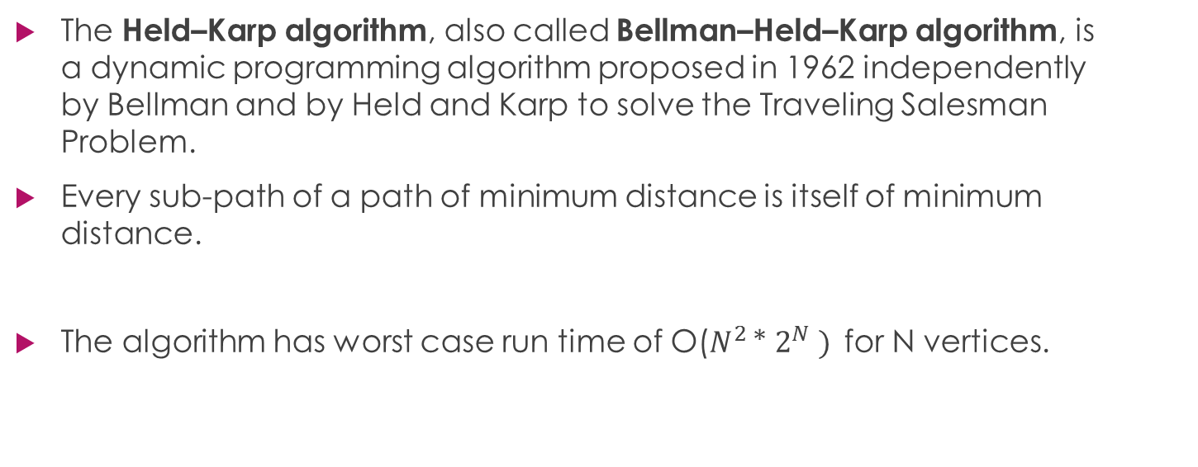
Dynamic Programming approach
The Held–Karp algorithm, also called Bellman–Held–Karp algorithm, is a dynamic programming algorithm proposed in 1962 independently by Bellman and by Held and Karp to solve the Traveling Salesman Problem.
Every sub-path of a path of minimum distance is itself of minimum distance.
The algorithm has worst case run time of O($N^{2 }$* $2^{N} )$for N vertices.

Slide 14
Held Karp Algorithm
Number the cities 1, 2, . . . , N and assume we start at city 1, and the distance between city i and city j is d_{ij}.
Consider subsets S ⊆ {2, . . . , N} of cities and, for c ∈ S, let D(S, c) be the minimum distance, starting at city 1, visiting all cities in S and finishing at city c.
First phase: if S = {c}, then D(S, c) = d_{1,c}. Otherwise: D(S, c) = min_{x∈S−c} (D(S − c, x) + d_{x,c} )
Second phase: the minimum distance for a complete tour of all cities is M = min_{c∈{2,...,N}} (D({2, . . . , N}, c) + d_{c,1} )

Slide 15
Branch and Bound approach
A branch-and-bound algorithm consists of a systematic enumeration of candidate solutions by means of state space search.
the set of candidate solutions is thought of as forming a rooted tree with the full set at the root.
The algorithm explores branches of this tree, which represent subsets of the solution set.
Before enumerating the candidate solutions of a branch, the branch is checked against upper and lower estimated bounds on the optimal solution, and is discarded if it cannot produce a better solution than the best one found so far by the algorithm.

Slide 16
Branch and Bound algorithm
Let S be some subset of solutions. L(S)=a lower bound on the cost of any solution belonging to S.
Let C=cost of the best solution found so far
If C ≤ L(S),there is no need to explore S because it does not contain any better solution.
If C > L(S),then we need to explore S because it may contain a better solution.

Slide 17
Special case: Assuming Triangle inequality to hold
Definition : If for the set of vertices a, b, c ∈ V , it is true that W(a, c) ≤ W(a, b) + W(b, c) where W is the cost function, we say that W satisfies the triangle inequality.
We create a minimum spanning tree the weight of which is a lower bound on the cost of an optimal traveling salesman tour.
Using this minimum spanning tree we will create a tour the cost of which is at most 2 times the weight of the spanning tree.

Slide 18
Special case: Assuming Triangle inequality to hold
Approximation-TSP
Input: A complete graph G (V, E)
Output: A Hamiltonian cycle
1. Select a “root” vertex r ∈ V [G].
2. Use MST-Prim (G, c, r) to compute a minimum spanning tree from r.
3. Assume L to be the sequence of vertices visited in a preorder tree walk of T.
4. Return the Hamiltonian cycle H that visits the vertices in the order L.
Approximation-TSP is a 2-approximation algorithm with polynomial cost for the traveling salesman problem given the triangle inequality.

Slide 19

Heuristic Solutions: Nearest Neighbor O($N^{2}$)
This is perhaps the simplest and most straightforward TSP heuristic.
The key to this algorithm is to always visit the nearest city.
1. Select a random city.
2. Find the nearest unvisited city and go there.
3. Are there any unvisited cities left? If yes, repeat step 2.
4. Return to the first city.
The Nearest Neighbor algorithm will often keep its tours within 25% of the Held-Karp lower bound.

Slide 20
Heuristic Solutions: Greedy
The Greedy heuristic gradually constructs a tour by repeatedly selecting the shortest edge and adding it to the tour as long as it doesn’t create a cycle with less than N edges, or increases the degree of any node to more than 2.

Slide 21

Greedy algorithm O($N^{2}$ * $\log_{2}{N}$)
1. Sort all edges.
2. Select the shortest edge and add it to our tour if it doesn’t violate any of the constraints we saw on the last slide.
3. Do we have N edges in our tour? If no, repeat step 2.
The Greedy algorithm normally keeps within 15- 20% of the Held-Karp lower bound.

Slide 22
Insertion Heuristics
The basics of insertion heuristics is to start with a tour of a subset of all cities, and then inserting the rest by some heuristic.
The initial sub tour is often a triangle or the convex hull.
One can also start with a single edge as sub tour.

Slide 23

Nearest Insertion, O($N^{2}$)
1. Select the shortest edge, and make a sub tour of it.
2. Select a city not in the sub tour, having the shortest distance to any one of the cities in the sub tour.
3. Find an edge in the sub tour such that the cost of inserting the selected city between the edge’s cities will be minimal.
4. Repeat step 2 until no more cities remain.

Slide 24

Convex Hull O($N^{2}$ * $\log_{2}{N}$)
1. Find the convex hull of our set of cities, and make it our initial sub tour.
2. For each city not in the sub tour, find its cheapest insertion (as in step 3 of Nearest Insertion). Then chose the city with the least cost/increase ratio, and insert it.
3. Repeat step 2 until no more cities remain.

Slide 25
Christofides heuristic
Most heuristics can only guarantee a worst-case ratio of 2 (i.e. a tour with twice the length of the optimal tour).
Professor Nicos Christofides extended one of these algorithms and concluded that the worst-case ratio of that extended algorithm was 3/2.
This algorithm is commonly known as Christofides heuristic.

Slide 26

Christofides Algorithm O($N^{3}$)
Create a minimum spanning tree T of G.
Let O be the set of vertices with odd degree in T. By the handshaking lemma, O has an even number of vertices.
Find a minimum-weight perfect matching M in the induced subgraph given by the vertices from O.
Combine the edges of M and T to form a connected multigraph H in which each vertex has even degree.
Form an Eulerian circuit in H.
Make the circuit found in previous step into a Hamiltonian circuit by skipping repeated vertices (shortcutting).

Slide 27
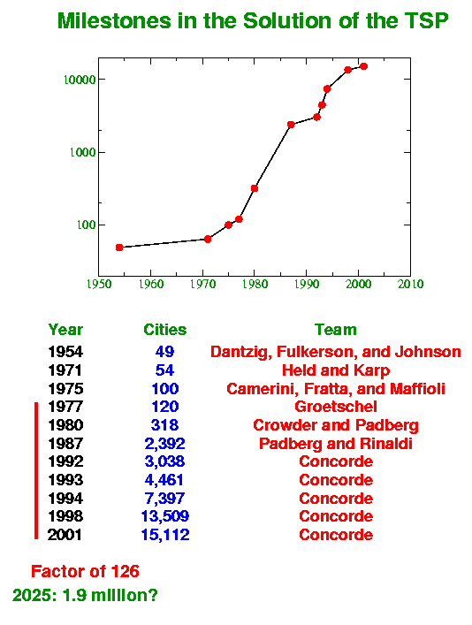
Over the Years

Slide 28
MAXIMUM FLOW PROBLEM

Slide 29
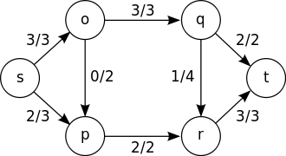
Overview
In optimization theory, maximum flow problems involve finding a feasible flow through a single-source, single-sink flow network that is maximum.
courtesy : Wikipedia

Slide 30

Formal Problem Statement
Let G=(V,E) be a network with s , t ∈ V being the source and the sink of G respectively.
Definition:The capacity of an edge is a mapping c : 𝐄 →ℜ+ denoted by c(u,v) It represents the maximum amount of flow that can pass through an edge.
Definition: A flow is a mapping f : 𝐄 →ℜ+ , denoted by f(u,v), subject to the following two constraints:
(Capacity Constraint)
(Conservation Constraint)
Definition. The value of flow is defined by
PROBLEM : max | f |

Slide 31
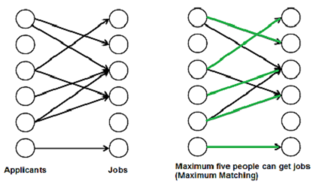
Applications of the Maximum Flow Problem
Bipartite Graphs Matching Problem
A matching in a Bipartite Graph is a set of the edges chosen in such a way that no two edges share an endpoint. A maximum matching is a matching of maximum size (maximum number of edges). In a maximum matching, if any edge is added to it, it is no longer a matching. There can be more than one maximum matchings for a given Bipartite Graph.
There are many real world problems that can be formed as Bipartite Matching. For example, consider the following problem:
There are M job applicants and N jobs. Each applicant has a subset of jobs that he/she is interested in. Each job opening can only accept one applicant and a job applicant can be appointed for only one job. Find an assignment of jobs to applicants in such that as many applicants as possible get jobs.

Slide 32
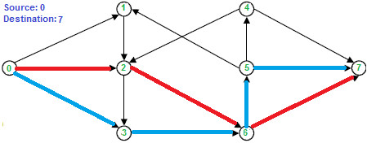
Applications of the Maximum Flow Problem
Edge-Disjoint Paths
(Two paths are edge-disjoint if they have no arc in common)
INSTANCE: Directed graph G(V, E) with two distinguished nodes s and t.
SOLUTION: The maximum number of edge-disjoint paths between s and t.

Slide 33
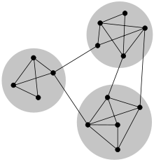
Applications of the Maximum Flow Problem
Network Connectivity
In mathematics and computer science, connectivity is one of the basic concepts of graph theory: it asks for the minimum number of elements (nodes or edges) that need to be removed to disconnect the remaining nodes from each other. The connectivity of a graph is an important measure of its resilience as a network.
INSTANCE: Directed graph G(V, E) with two distinguished nodes s and t.
SOLUTION: The minimum number of nodes which needs to be removed to disconnect the graph.

Slide 34
Applications of the Maximum Flow Problem
Baseball elimination problem.
Set of teams X.
Distinguished team x ∈ X.
Team i has won w_{i} games already.
Teams i and j play each other r_{ij} additional times.
Is there any outcome of the remaining games in which team x finishes with the most (or tied for the most) wins?

Slide 35
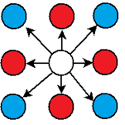
Applications of the Maximum Flow Problem
Image Segmentation Problem
INSTANCE: Pixel graphs G=(V, E), likelihood functions a, b : V → R+, penalty function p : E → R +
SOLUTION: Optimum labelling : partition of the pixels into two sets A and B that maximises q(A, B) = Σ_{i ∈ A} a_{i} + Σ_{j ∈ B} b_{i} - Σ_{i ∈ A , j ∈ B} p_{ij}

Slide 36
Solutions to Maximum Flow Problem
We look at various deterministic solutions that have been proposed to solve the general problem as well as special cases where justified restrictions have been imposed on the problem

Slide 37
Ford-Fulkerson Algorithm
Ford-Fulkerson-algo(G,s,t)
{ f ⬅ 0;
While (there is s-t path in G_{f} ) do // G_{f} is the residual graph
{ Let P be an s-t path in G_{f}
Let c′ be bottleneck capacity of P;
For each (x,y) ∈ P do
{ If (x,y) is a forward edge then
f(x,y) ⬅ f(x,y) + c′;
Else
f(y,x) ⬅ f(y,x) - c′;
}
} return f;
}

Slide 38
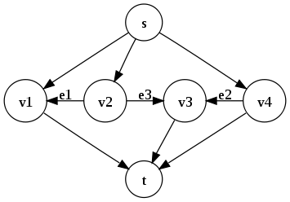
Ford-Fulkerson Algorithm
The algorithm is only guaranteed to terminate if all weights are rational. Otherwise it is possible that the algorithm will not converge to the maximum value. However, if the algorithm terminates, it is guaranteed to find the maximum value.
Time Complexity of the Algorithm: O(E | f |_{max}) where |f|_{max} is the maximum flow in the network.
Image Courtesy : Wikipedia
w(e₁) = 1
w(e₂) =
w(e₃) = 1
The algorithm chooses path at random. There are ways to choose path s.t the algorithm does not terminate.

Slide 39
Ford-Fulkerson Algorithm
The algorithm is poor in complexity and does not guarantee a solution for real weight edges but still this algorithm is of much significance. The genius idea of the algorithm was used to extend and modify it to improve the time complexity and solvable for real weights.
The algorithm also provides an elegant proof and insight to one of the important theorems of Graph Theory- Max Flow Min Cut Theorem.

Slide 40
MINIMUM CUT PROBLEM

Slide 41
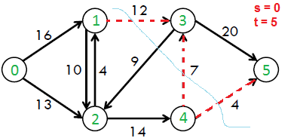
Definition
In optimization theory, minimum cut problem is a problem of finding a partition of the vertices of a graph into two disjoint subsets such that some property(value) associated with the cut is minimised.
Image Courtesy : geeksforgeeks

Slide 42
Cut Functions
Let G=(V,E) be a graph
Given a set of (non necessarily symmetric) weights d : V × V → R+, and A ⊂ V we define the cut as F(A) = d(A,Ā) = ∑_{i ∊ A , j ∊ Ā} d(i, j),
Here F(A) is a submodular function and we can minimise a submodular function in strongly polynomial time provided there are no constraints.

Slide 43
Formal Problem Statement
Definition. An s-t cut C = (S, T) is a partition of V such that s ∈ S and t ∈ T. The cut-set of C is the set
Definition. The capacity of an s-t cut is defined by where d_{ij}= 1 if i ∈ S and j ∈ T,
= 0 otherwise
Minimum s-t Cut Problem. Minimize c(S, T), that is, to determine S and T such that the capacity of the S-T cut is minimal.

Slide 44
Max-Flow Min-Cut Theorem
In optimization theory, the max-flow min-cut theorem states that in a flow network, the maximum amount of flow passing from the source to the sink is equal to the total weight of the edges in the minimum cut, i.e. the smallest total weight of the edges which if removed would disconnect the source from the sink.
The max-flow min-cut theorem is a special case of the duality theorem for linear programs.
The max-flow min-cut theorem was proven by P. Elias, A. Feinstein, and C.E. Shannon in 1956, and independently also by L.R. Ford, Jr. and D.R. Fulkerson in the same year.

Slide 45

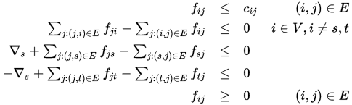
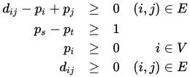
Linear Programming Formulation
PRIMAL(max-flow) DUAL(min-flow) maximise minimise subject to subject to

Slide 46
Reduction to Polynomial Time
For about 10 years of time after Ford–Fulkerson algorithm was invented, it was unknown if it can be made to terminate in polynomial time in the generic case of irrational edge capacities. This caused lack of any known polynomial time algorithm that solved max flow problem in generic case.
Dinitz algorithm and the Edmonds–Karp algorithm, which was published in 1972, independently showed that in the Ford–Fulkerson algorithm, if each augmenting path is the shortest one, the length of the augmenting paths is non-decreasing and it always terminated.

Slide 47
Modified Ford-Fulkerson Algorithm (for integer weighted graphs)
The Ford-Fulkerson Algorithm gives us the flexibility to choose any path from the source to sink. The idea to reduce the complexity lies in choice of our path. For integer weighted graphs, instead of any path if we choose paths with maximum capacity then we can reduce the complexity to polynomial time. Theorem: Given a flow network G = (V,E) where edge capacities are integers,the modified algorithm runs in O(|E|² log c_{max} ) where c_{max} is the maximum capacity of any edge.
IMPROVEMENT (to polynomial time): O(E | f |_{max}) to (O(|E|² log c_{max} )
where |f|_{max} is the maximum flow in the network.

Slide 48
Edmonds-Karp Algorithm
This algorithm is a slight modification of the Ford-Fulkerson Algorithm where we restrict our method of path selection to the shortest path in the residual graph at each iteration
This algorithm can solve the max-flow problem for real positive weights in polynomial time. This is an achievement compared to the previous algorithm which was possible for integer weights only. Time Complexity : O(|E|² |V| )

Slide 49
Dinitz’s Algorithm or Dinic’s Algorithm
This algorithm was developed by Israeli computer scientist Yefim A. Dinitz. Unlike the Edward-Karp Algorithm, this algorithm was not derived from the idea of Ford-Fulkerson Algorithm.
Yefim Dinitz invented this algorithm in response to a pre-class exercise in Adel'son-Vel'sky's (co-inventor of AVL trees) Algorithm class. Dinitz introduced the concept of blocking flow in a layered graph which is the key idea used in his algorithm for max-flow.

Slide 50
Dinitz’s Algorithm or Dinic’s Algorithm
In each phase the algorithms builds a layered graph with breadth-first search on the residual graph. The maximum flow in a layered graph can be calculated in O(|V||E|) time, and the maximum number of the phases is |V|-1.
Time Complexity = O ( |V|²|E|)
This algorithm is an improvement over the Edward-Karp Algorithm which takes O(|E|² |V| ) time to compute max-fow.
Another key advantage: Many applications like Bipartite Matching , computing Edge-Disjoint Paths are special cases of max-flow i.e. with unit edge capacities. In this case the time complexity of Dinitz’s Algorithm reduces to O(|E|.min{|V|^{⅔}|E|^{½}}) complexity which is a huge improvement.

Slide 51
Link to IIT KANPUR
In 1978, a paper was published titled An (O|V|³) Algorithm for finding Maximum Flow in Networks. The algorithm described in the paper works for all acyclic graphs with real weight edges and was a considerable improvement over the then known best solution of O(|E| |V|² ) time complexity. The paper was published by V.M. MALHOTRA, M. PRAMOTH KUMAR and S.N. MAHESHWARI who are former faculty of IIT Kanpur. The algorithm is popularly known as MKM Algorithm.

Slide 52
Improvements
Since the origin of the problem, there had been several improvements in reduce the time complexity but they required certain constraints in the properties of the graph like Integer - weight edge capacities Layered Graph Acyclic Graph
Dinic’s Algorithm, where dynamic trees data structure is implemented to speed up the max flow in a layered graph to O(E log(V)) solves the max flow in O(VE log (V)).

Slide 53

Journey to Milestone
Another algorithm known as Push-relabel Algorithm was designed by Goldberg and Trajan in 1986 which computes the max-flow in O(V ²E) and was reduced to O(VElog(V ²/E)) using dynamic trees.
After this Trajan along with King and Rao developed a technique to compute the max flow in time.

Slide 54

Milestone
As recent as a 2013 development by J.Orlin, we now have a combination of algorithms to solve to solve the problem in a general graph in O(VE) time.
(Orlin + KRT)
Orlin’s algorithm solves the problem in O(VE) time when and the KRT solves it in O(VE) when E ≥ V^{1+є}

Slide 55
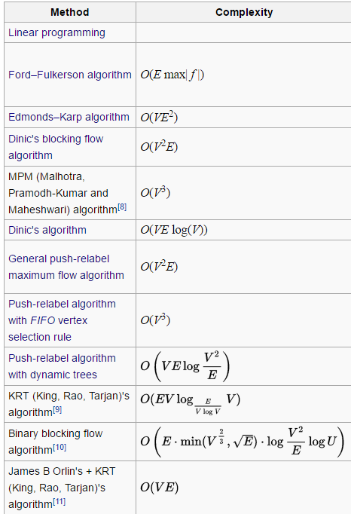
Conclusion
Source : wikipedia

Slide 56
Literature Findings
Ford-Fulkerson can outperform Edmond-Karp in specific cases, notably in grid graphs as depth-first search typically is faster on those. This was statistically proven by Laube and Nebel (2013).
The paper “An experimental comparison of max flow algorithms” (Friis, and Olesen, 2014) contains many pieces of information related to this. Edmond-Karp did generally underperform and some Goldberg-Tarjan with heuristics proved to be fastest on every test.

Slide 57


At the end - Tips for a good ppt

